Slide 1
Ticketmaster: Event Planning Visualization
Isaac Becker, Alex Stephens, David Adurogbola, & Dan Sinda

Slide 2
Telling A Story (Theme)
Datasets were gathered from Ticket Master API https://developer.ticketmaster.com/products-and-docs/apis/getting-started/
A login-page will define users while the datasets will be used to find the event/concert, date, city/state, and venue. In order to do this we will scrape the API dataset and the data will be transformed to better format time and add drop-down functionality for better visualization.
Lastly, for our database library we relied on SweetAlert (swal)

Slide 3
Methodology & Coding Approach
Database: Ticket Master API
Pulled data from the Ticket Master API on dates, events/concerts, city/state, and venue. Ran a javascript environment to produce a mapped visualization where customer facing users can select a date and location and receive recommendations for activities.
style.css helps format html files to create more visually appealing front end user interfaces.
JS Library: SweetAlert (swal)
A JavaScript animation library with a simple, yet powerful API.
This library integrates with SweetAlert Transformer to remove tedious manual tasks in creating nested DOM nodes while still being useful in producing advanced modal designs.

Slide 4
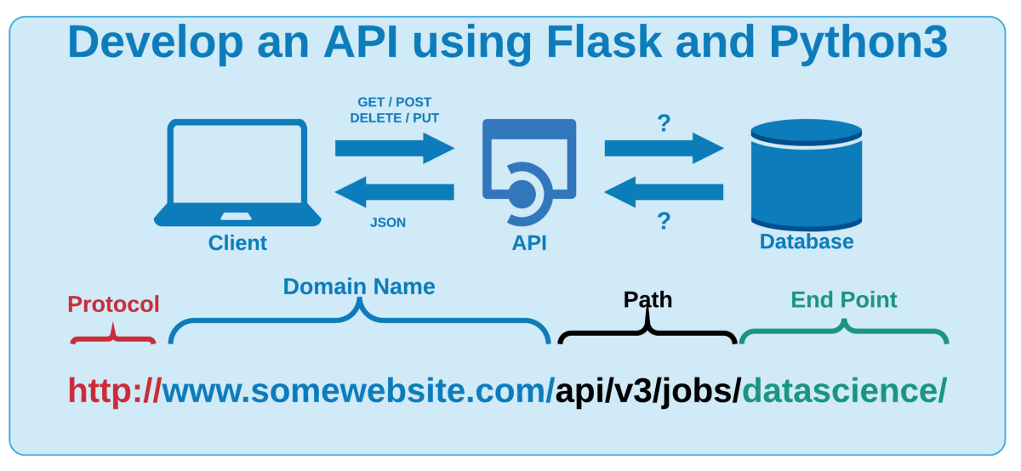
Developing the database around an API
Python Flask–powered API, HTML/CSS, JavaScript
Used database to store user login info.

Slide 5
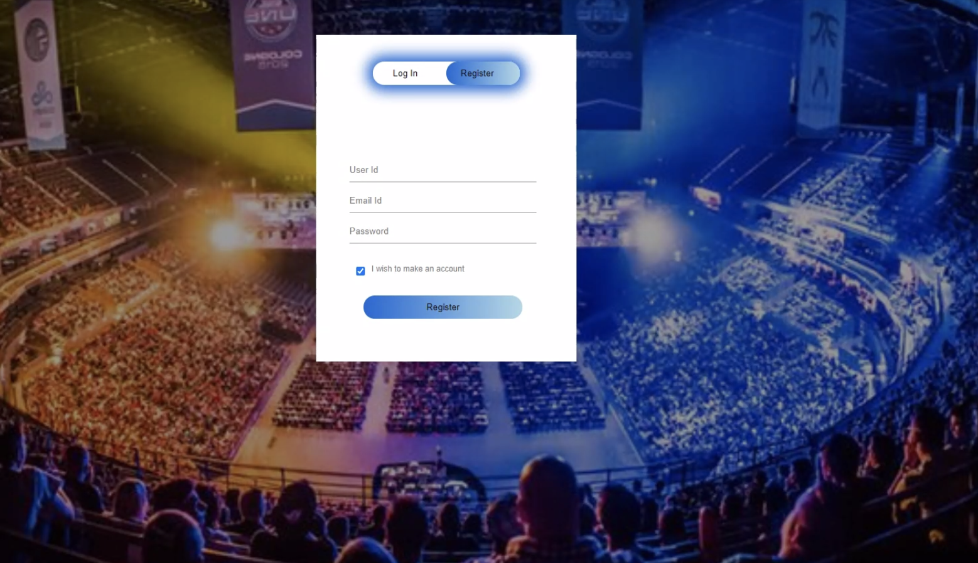
Final Visualization (View 1)

Slide 6
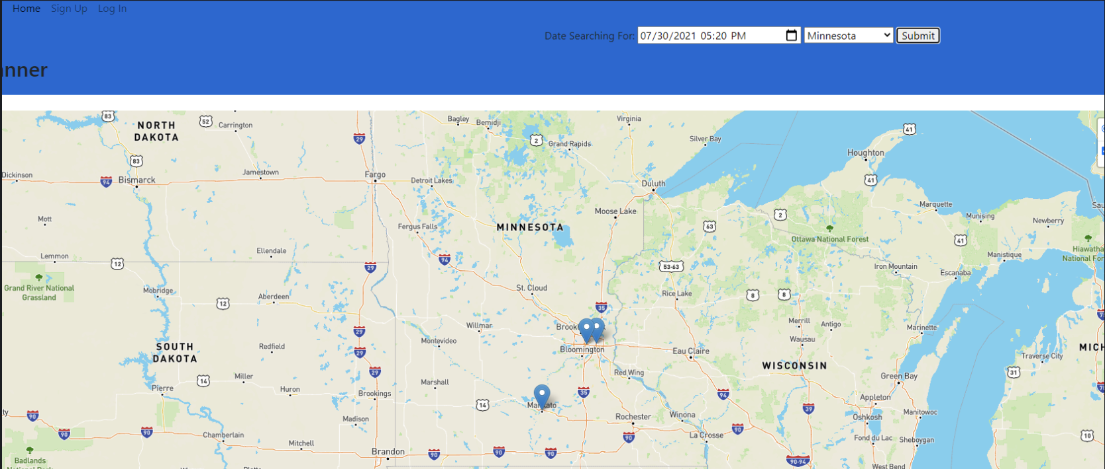
Final Visualization (View 2)

Slide 7
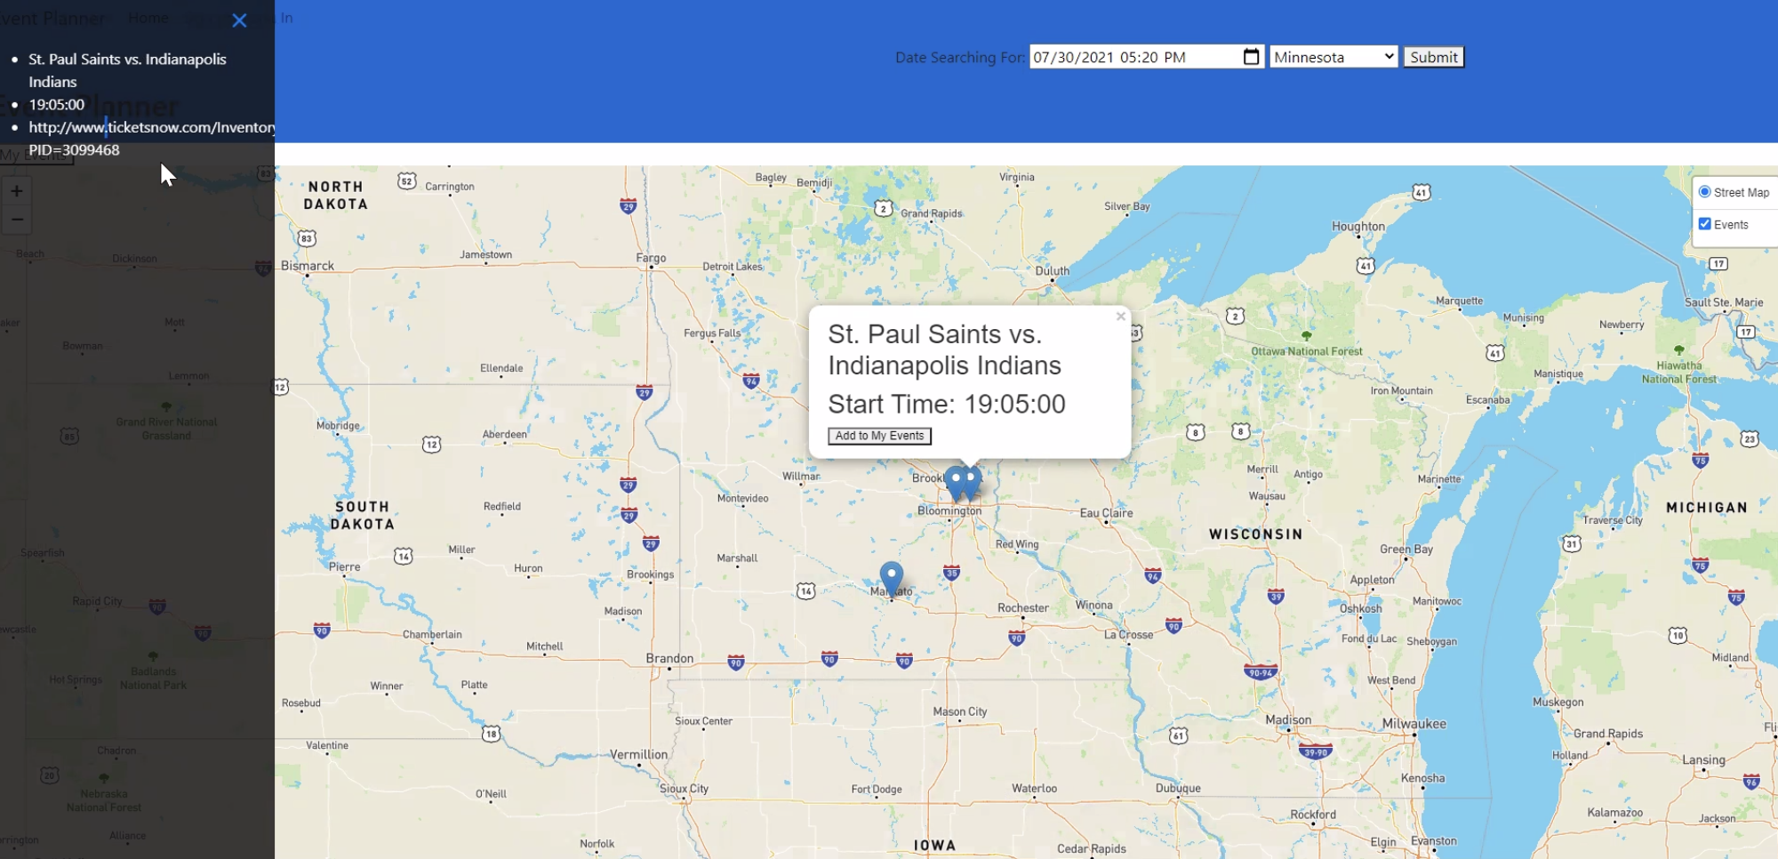
Final Visualization (View 3)

Slide 8
DEMO

Slide 9
QUESTIONS?

